Slide 1
Counter-Crowded
CSE 101 TERM PROJECT GROUP-20
Ali ÇELİK 210104004219
Arda ÇALTEPE 210104004243
Burak KURT 210104004225
Elif DENİZ 210104004239
Mehmet SARIŞ 210104004234
Taha Eren ŞAHİN 210104004214
Ziya Kadir TOKLUOĞLU 210104004228

Slide 2
AIM OF THE PROJECT
In the coronavirus (Covid-19) pandemic, a person restriction was imposed on closed areas under social distancing rules.
Counter-Crowded counts the number of people entering and leaving to confined spaces, raises awareness so that rules are not neglected and provides convenience to people.

Slide 3
WHERE CAN YOU USE IT?
We have designed this project to measure the number of people in closed areas due to the coronavirus (Covid-19) pandemic.
The scope of use of the project is wide and it can be used wherever we want to calculate the number of people in the places of entry and exit.

Slide 4
WHAT DO YOU NEED FOR COUNTER-CROWDED ?
Arduino Uno
2 x HC-SR04 Ultrasonic Distance Sensor
LCD 16x2 with I2C
2 x Breadboard
9V Battery & Battery Compartment
2 x RGB
Buzzer
4 x 330 ohm Resistance
Jumper Wires

Slide 5
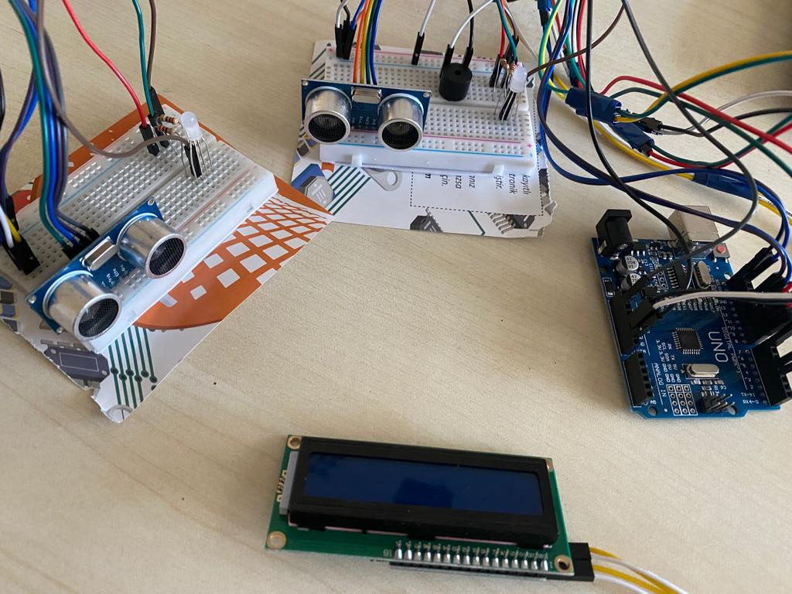

Slide 6
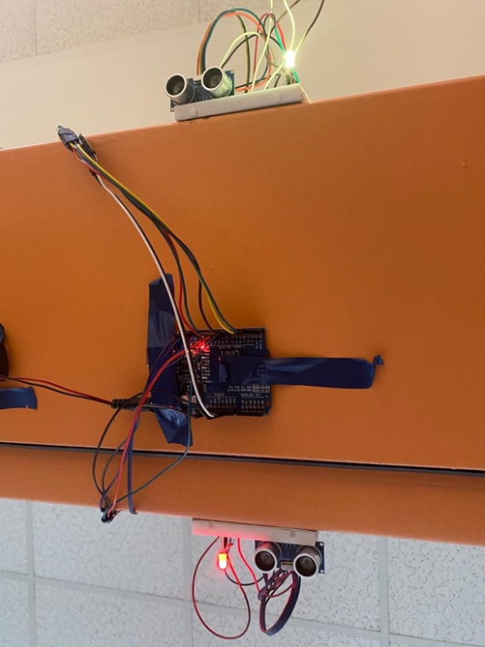
HOW IT WORKS?
The distance sensors we place on both sides of the door emits sound waves and it sends detected movements to the Arduino and the Arduino determines whether the person enters or leaves.
In the light of this information, the LEDs light up according to the situation and the LCD screen shows the status.

Slide 7
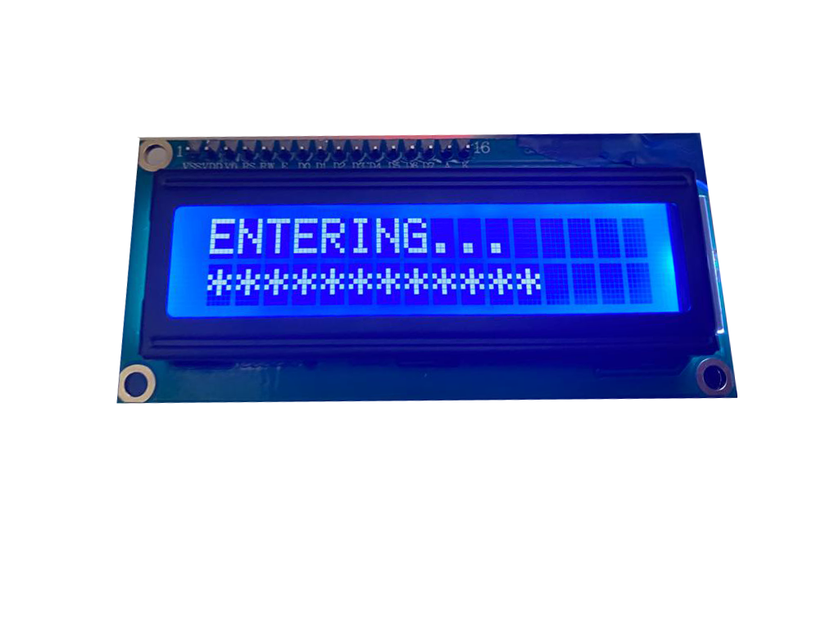
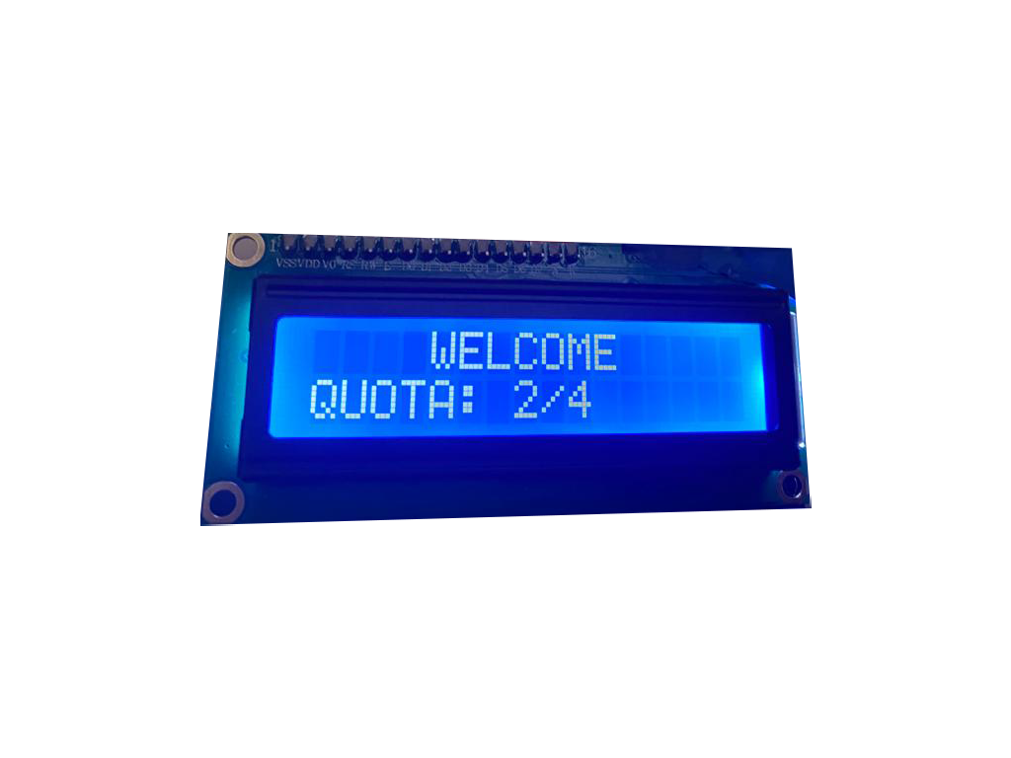
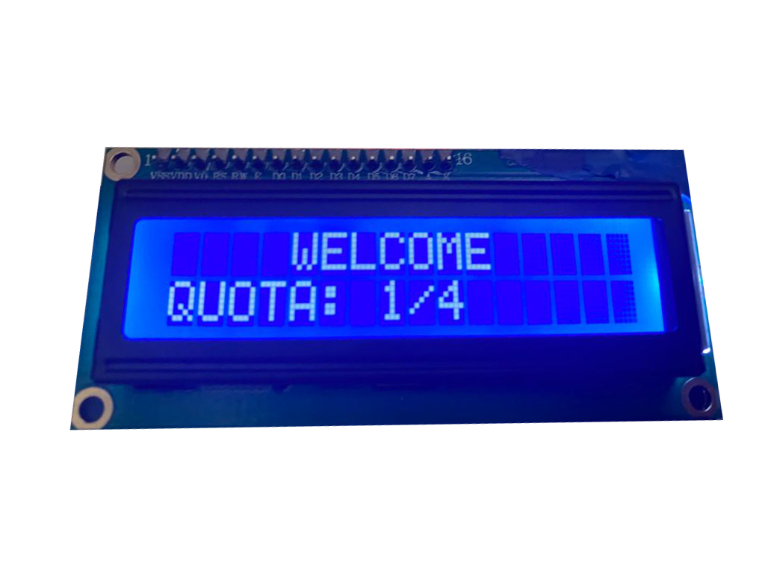
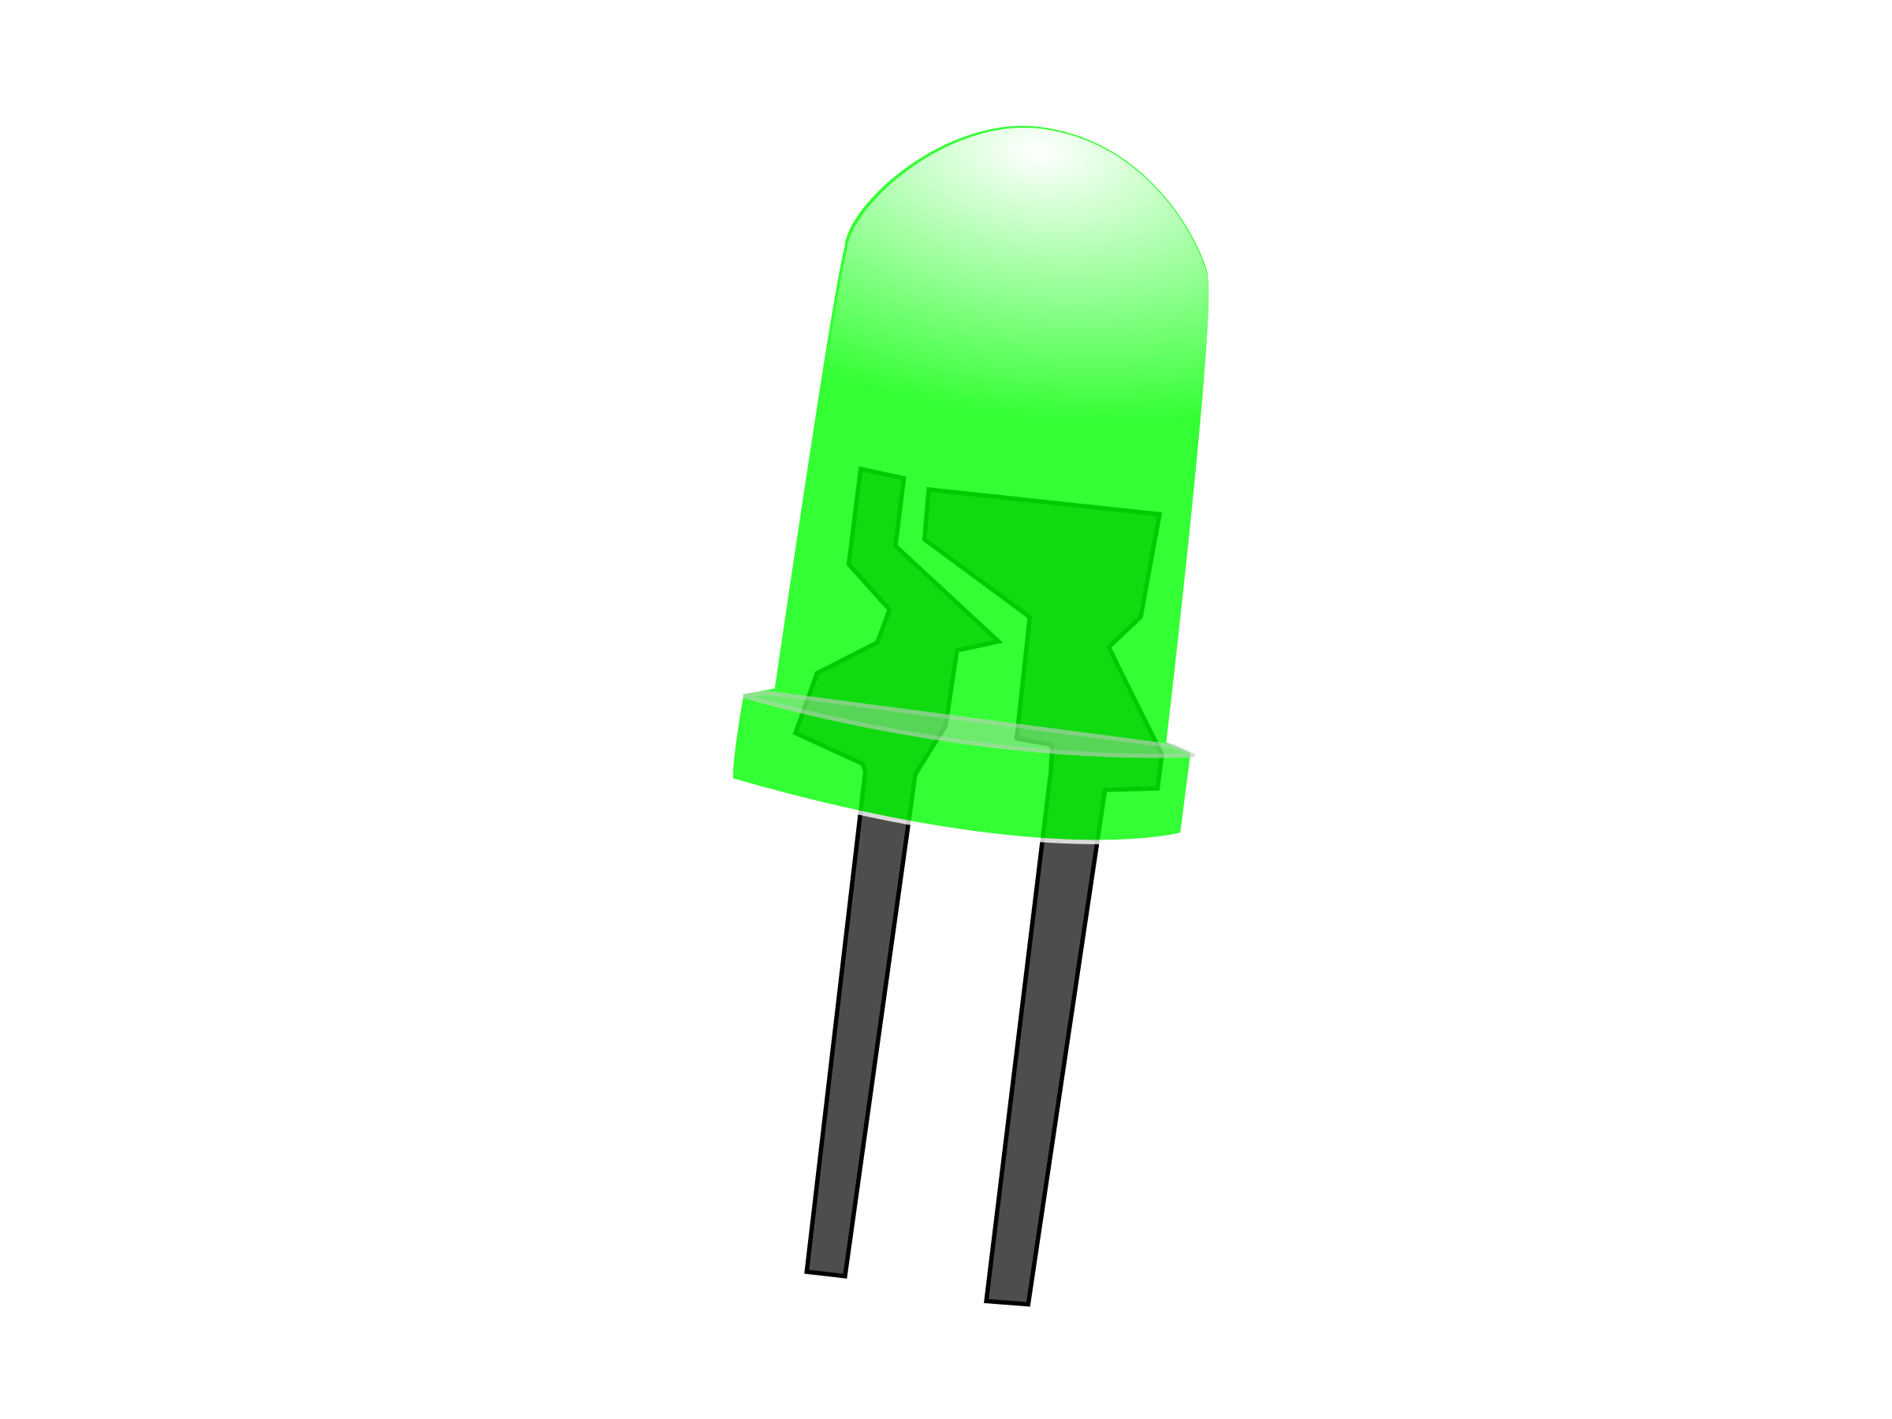
WHILE THE PERSON ENTERING
When we turn on the device for use, the LEDs indicating that it is suitable for entry start to turn green. When the person enters the door, the distance sensor detects and the "ENTERING" text is displayed on the LCD screen.

Slide 8
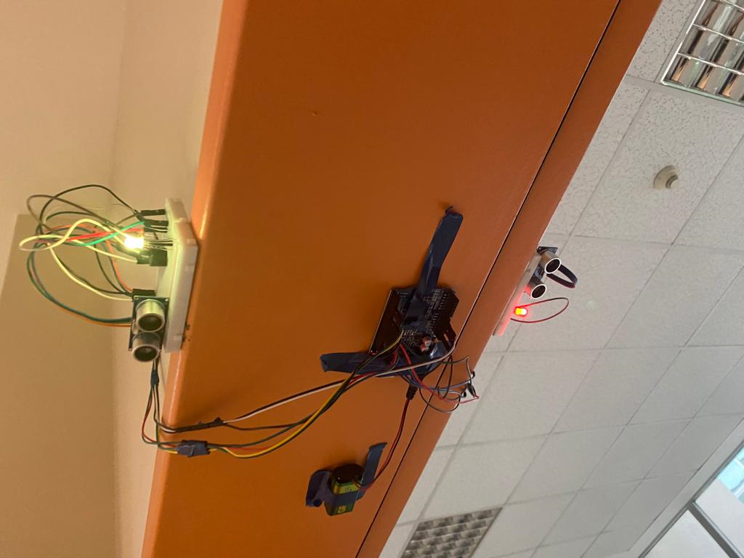
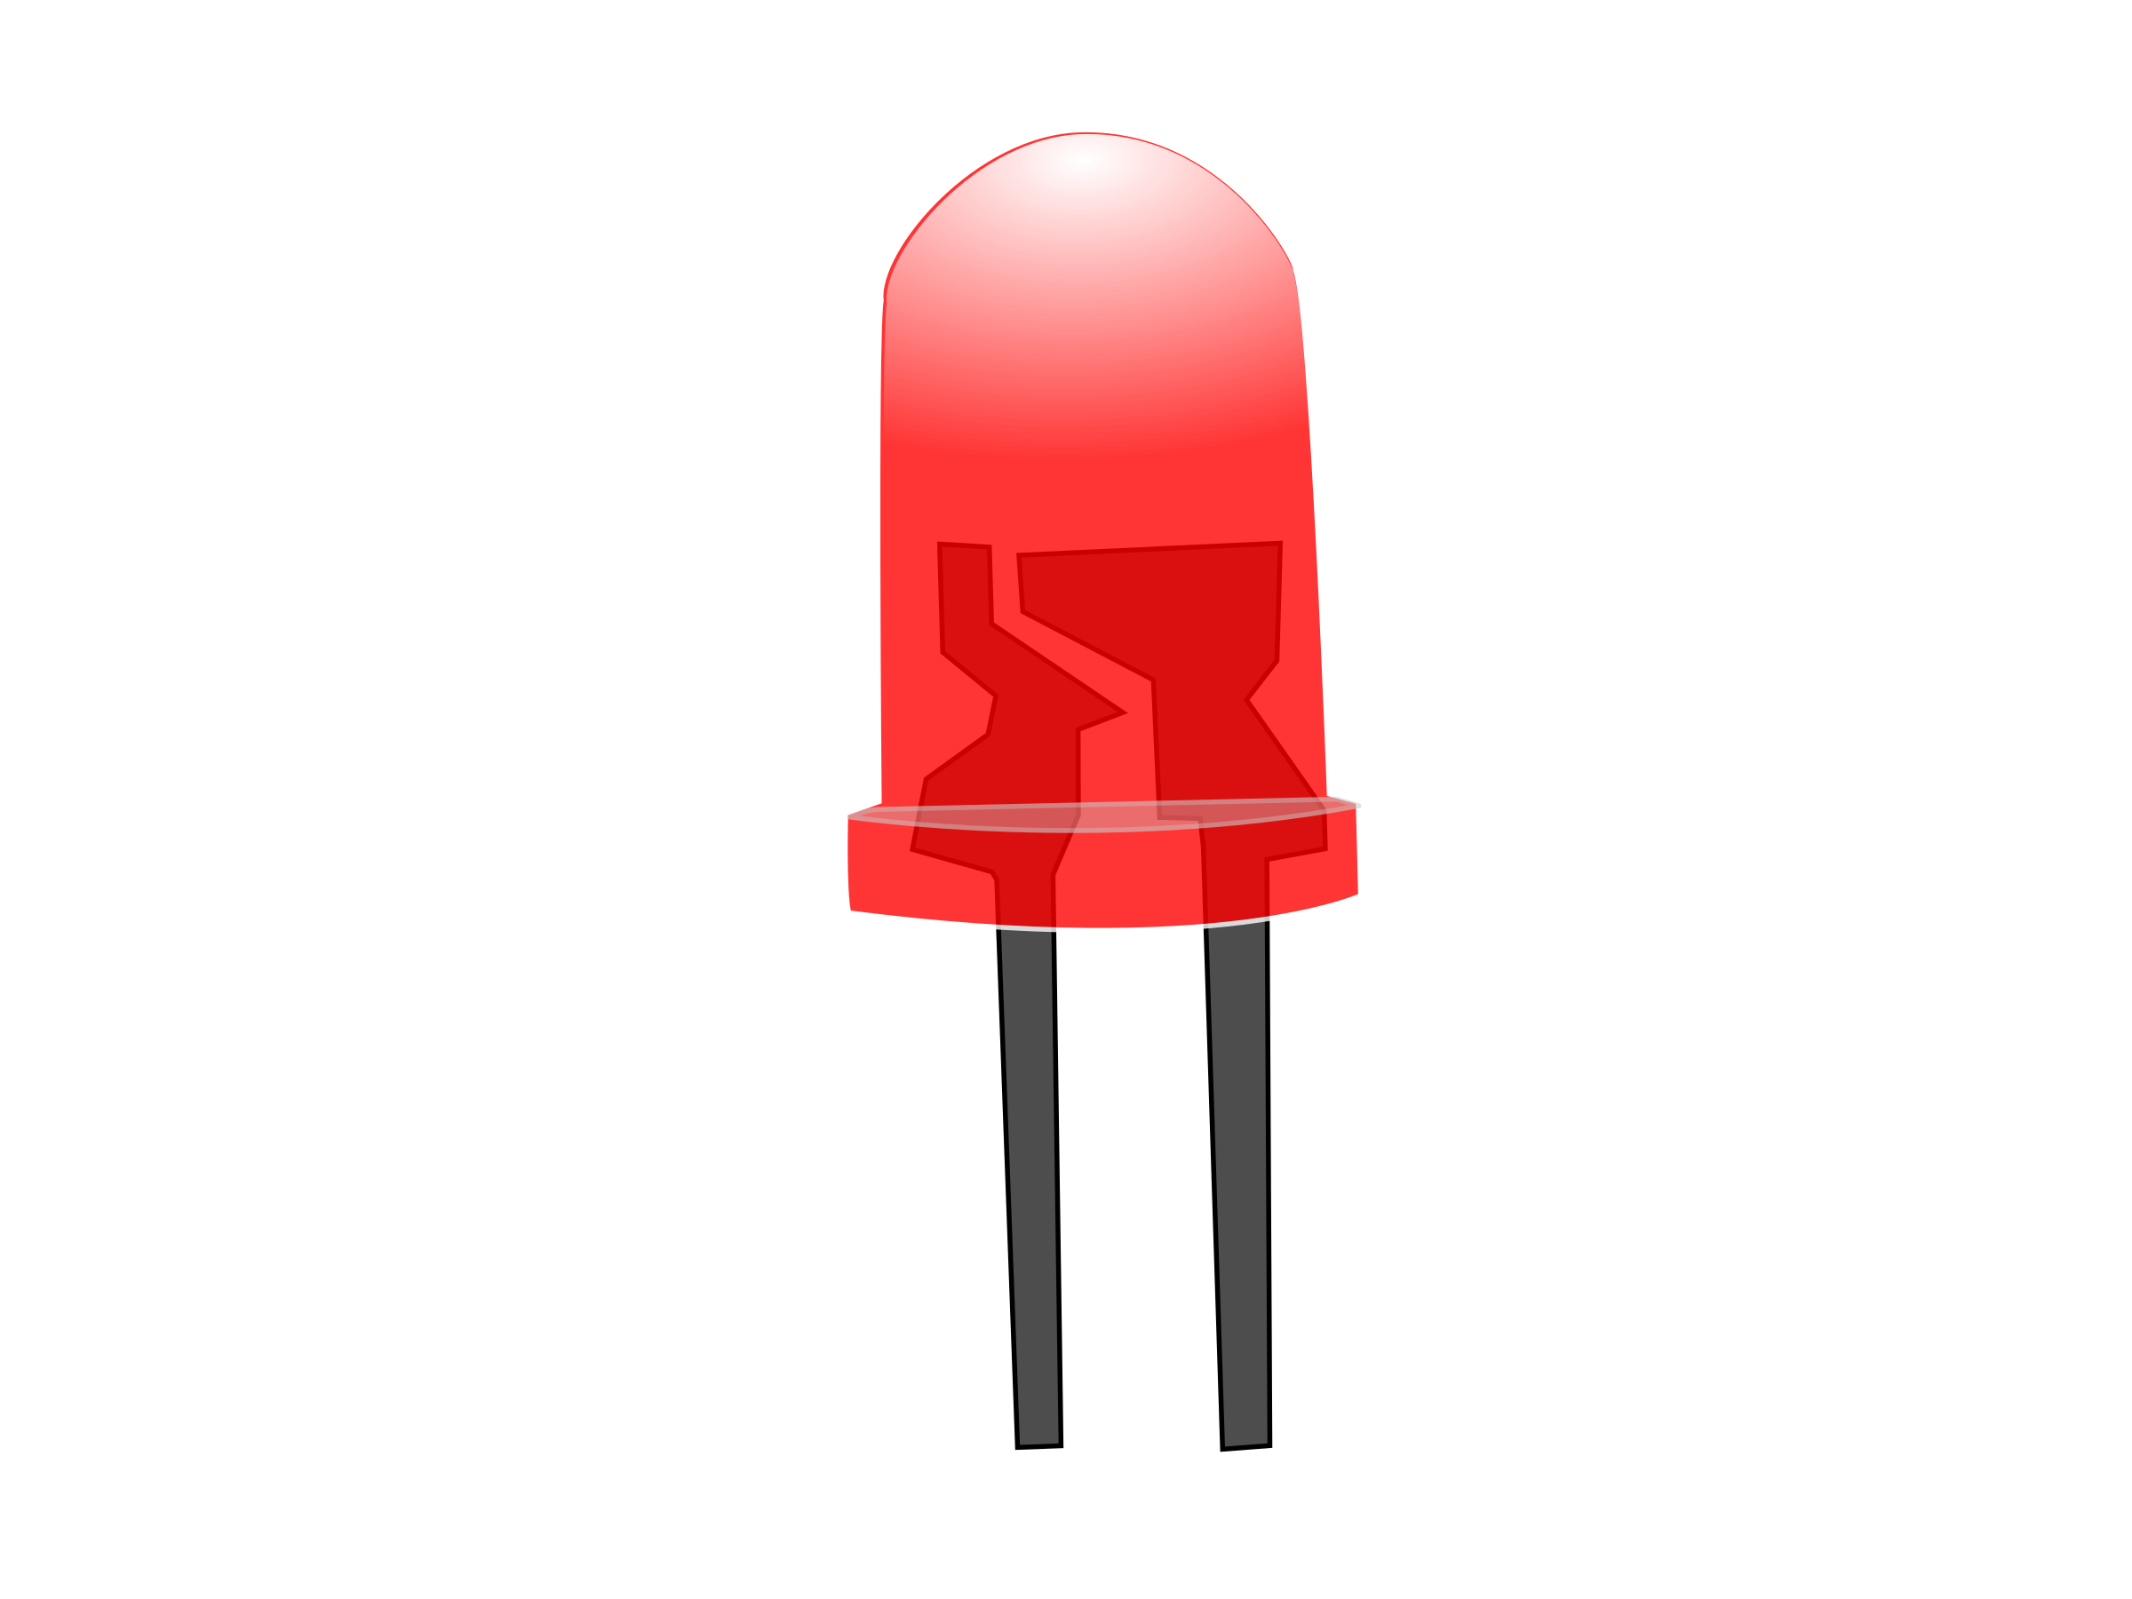

In order to prevent simultaneous entry and exit, the entrance led turns yellow when an entry is detected, and the exit led turns red, indicating that it is necessary to wait. Thus, the number of people is processed on the LCD screen

Slide 9
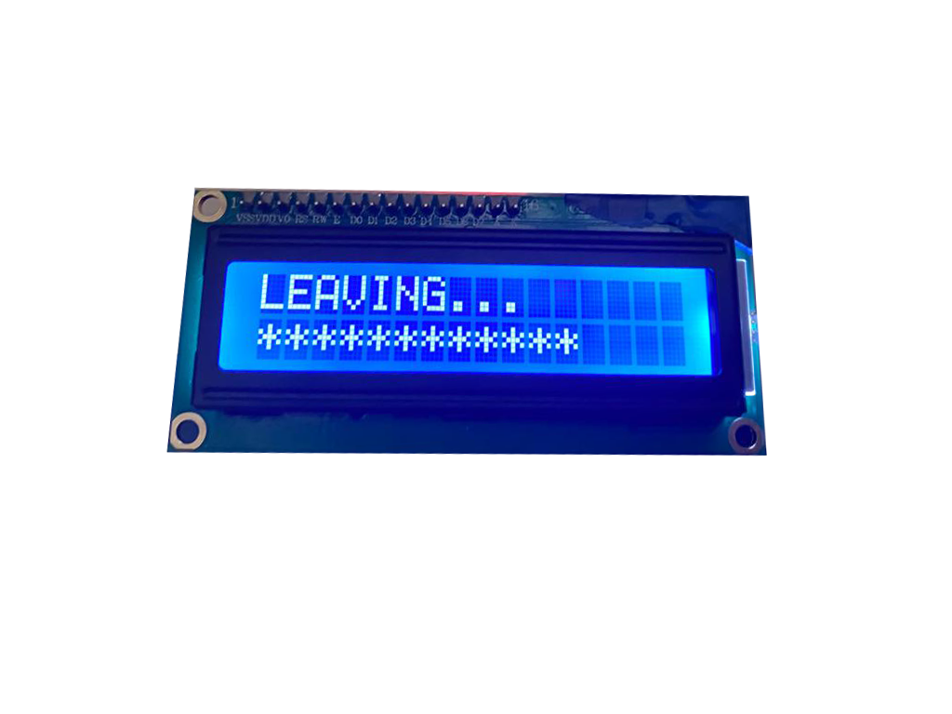
WHILE THE PERSON LEAVING
When the person goes out from the door, the distance sensor detects, and the LCD screen displays the text "LEAVING". The number of people displayed on the LCD screen decreases by one.

Slide 10
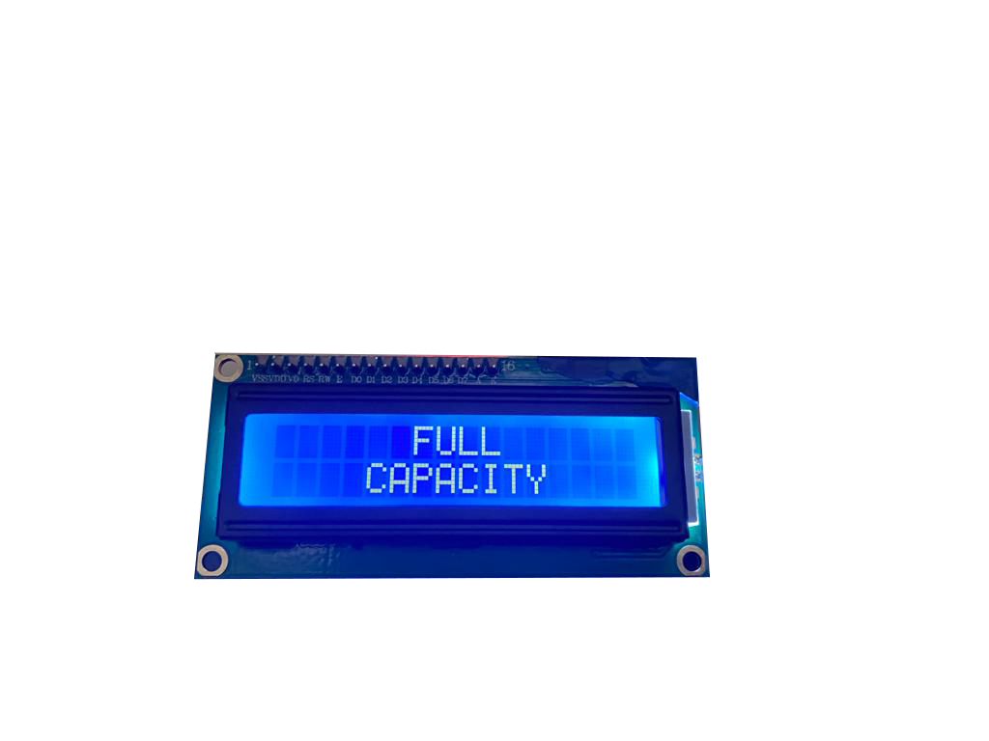
FULL CAPACITY
When the determined maximum number of people is reached, the LEDs turn red, the LCD screen shows "full capacity" and the buzzer sounds. So, people know that the capacity is full, and they should not enter. After the room reached full capacity, if someone try to enter buzzer will sound again.

